Slide 1
Task A: Closest Pair,
Step by Step
CS 413 · PIONEER DELIVERY PART II
Test A2: six delivery stops, one closest pair

Slide 2
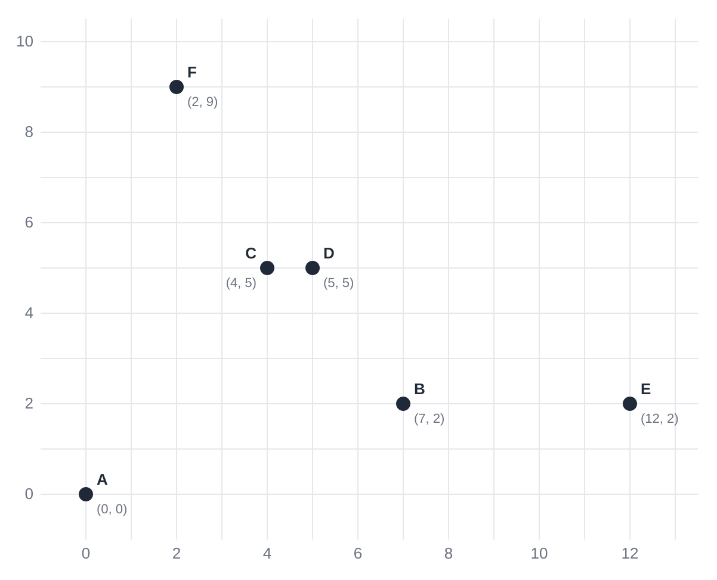
Find the two closest stops
THE PROBLEM
Six delivery stops from test A2.
Measuring every pair: 15 pairs here.
With 100,000 stops: about 5 billion pairs.
Divide and conquer gets the same answer while skipping almost all of them.
Expected answer: C, D with d² = 1.

Slide 3
Sort once, split down, solve the tiny groups, then choose, strip, and return at each level going up.
THE PLAN IN ONE LINE
The next slides show what each of those words means on test A2.

Slide 4
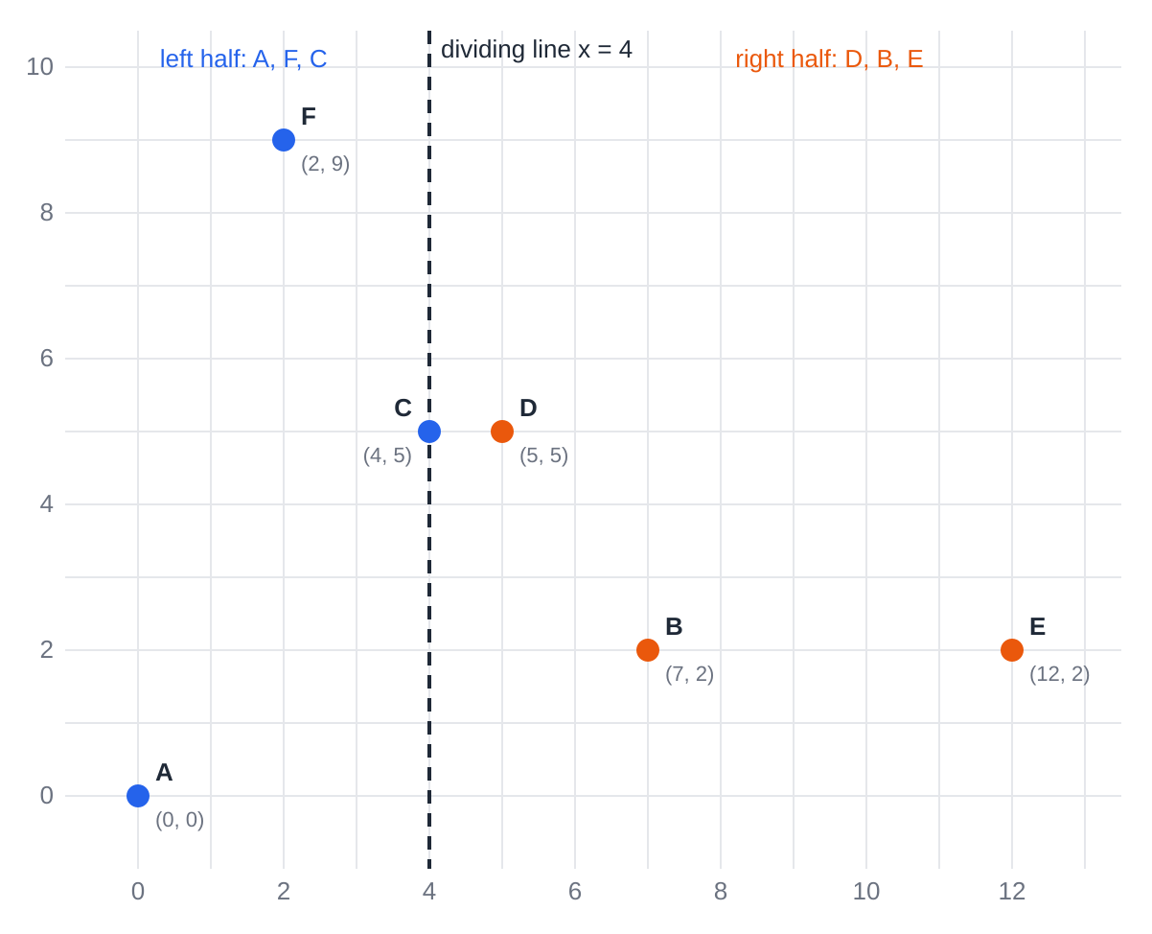
1 · Sort once and split
GOING DOWN
Sort by x: A, F, C, D, B, E.
Left half: A, F, C.
Right half: D, B, E.
The line goes through C, the last left point, at x = 4. C stays left because of its place in the sorted list.
Also sort by y, once: A, B, E, C, D, F. The y strip uses this later.

Slide 5
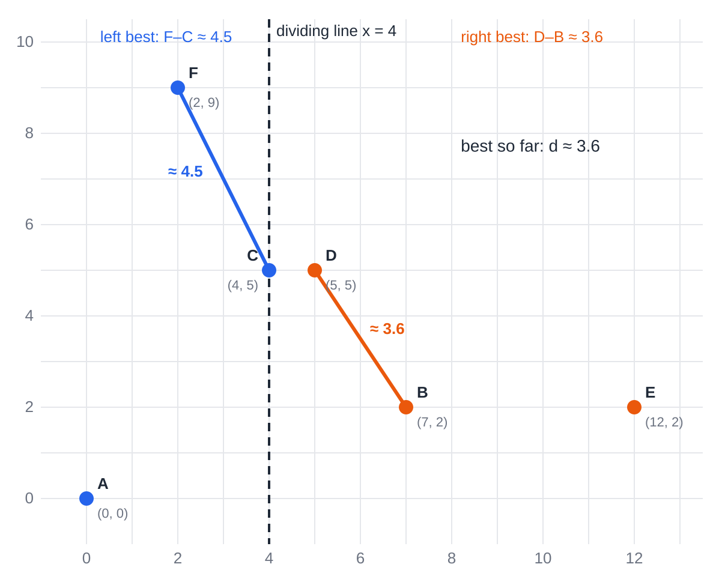
2 · Solve each half, choose d
BOTTOM, THEN CHOOSE
Each half has 3 points: small enough to measure every pair.
Left best: F–C ≈ 4.5
Right best: D–B ≈ 3.6
Choose the closer one: d ≈ 3.6, the best so far.
But the real answer, C–D, crosses the line. Neither half can see it.

Slide 6
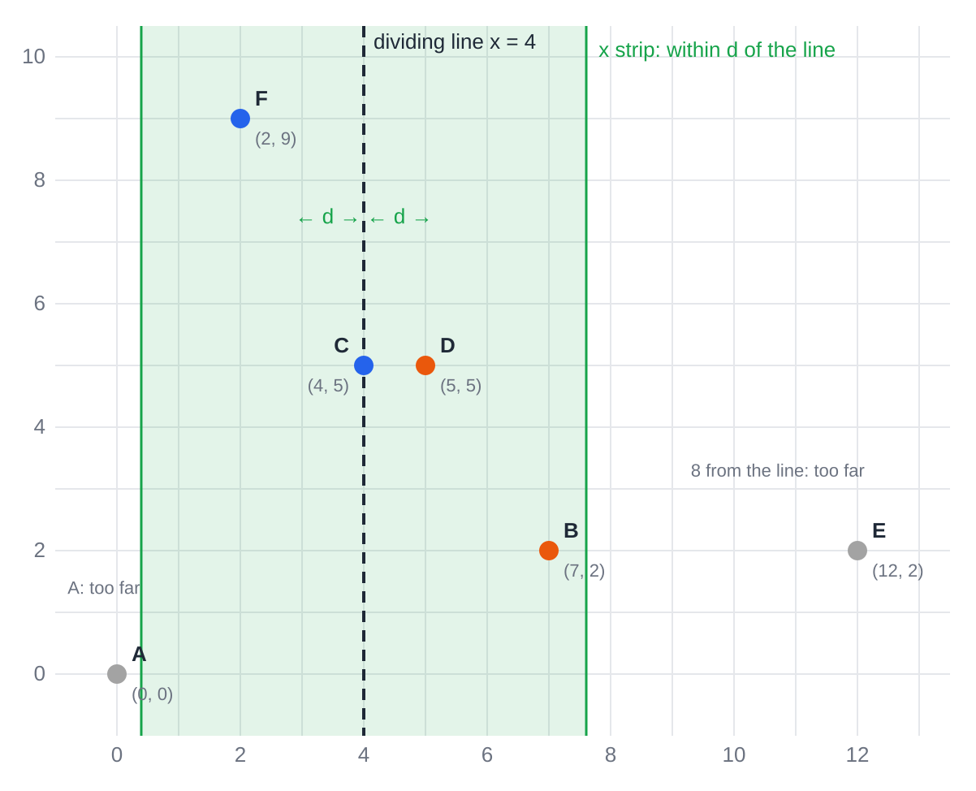
3 · The x strip
GOING UP: STRIP
A crossing pair closer than d must have both points within d of the line.
Keep only x from about 0.4 to 7.6.
A is 4 away and E is 8 away: both drop out.
Left in the strip: F, C, D, B.

Slide 7
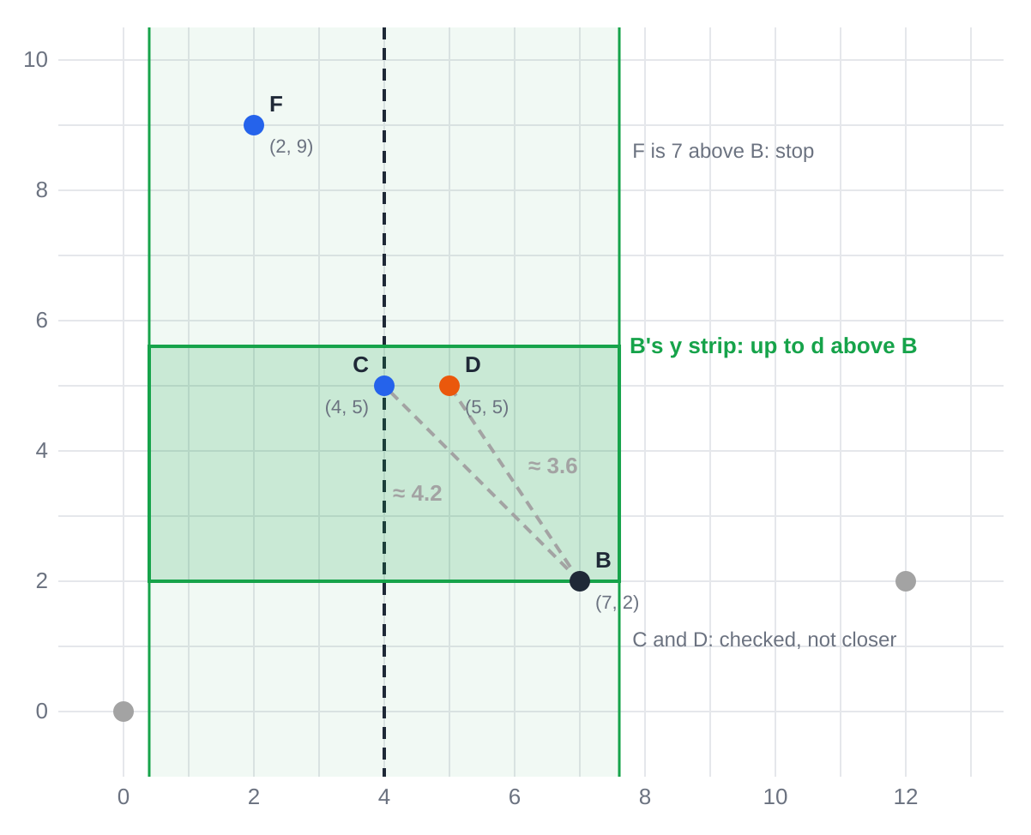
4 · The y strip: B’s turn
GOING UP: STRIP
Go bottom to top: B, C, D, F. This order comes free from the y sort.
B looks only up to d above itself.
C and D are inside: B–C ≈ 4.2, B–D ≈ 3.6. Not closer.
F is 7 above B: stop. Anything after F would be even higher.

Slide 8
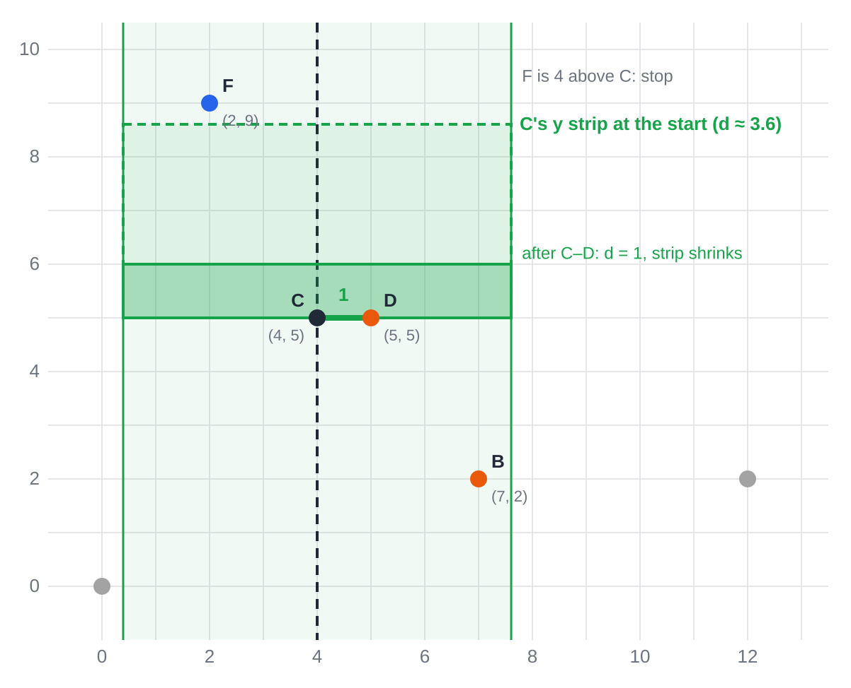
5 · The y strip: C’s turn
GOING UP: STRIP
D is inside C’s y strip: C–D = 1. A new best.
d drops to 1, so the y strip shrinks to 1 above C.
F is 4 above C: stop.
D’s turn: F is 4 above, more than 1, so stop. F has nothing above it.

Slide 9
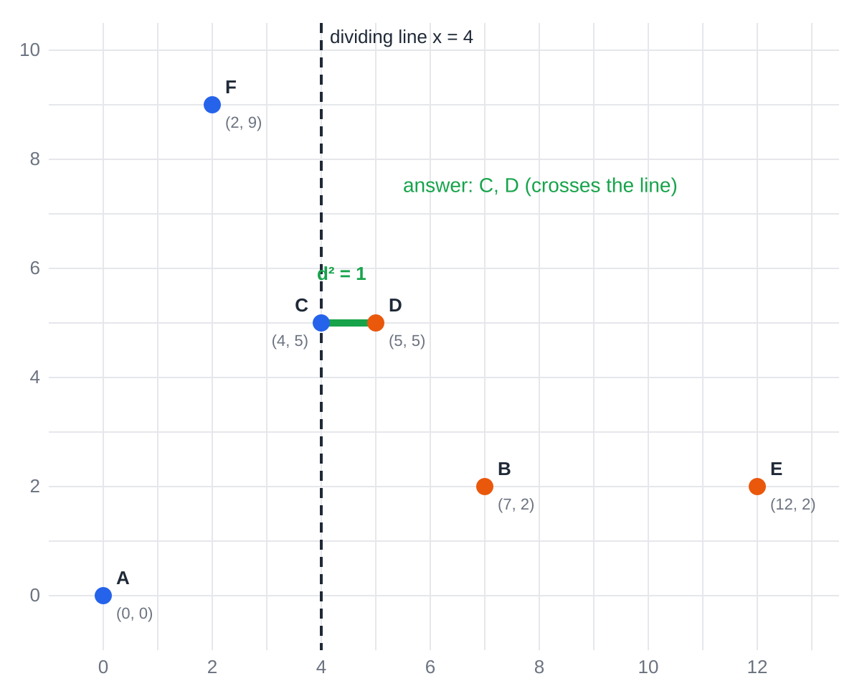
6 · The answer
TOP
C, D with d² = 1
This matches the expected result.
The pair crosses the line, which is exactly why the strip check exists.
Pairs measured: 3 + 3 in the halves, 3 in the strip. 9 instead of 15.

Slide 10
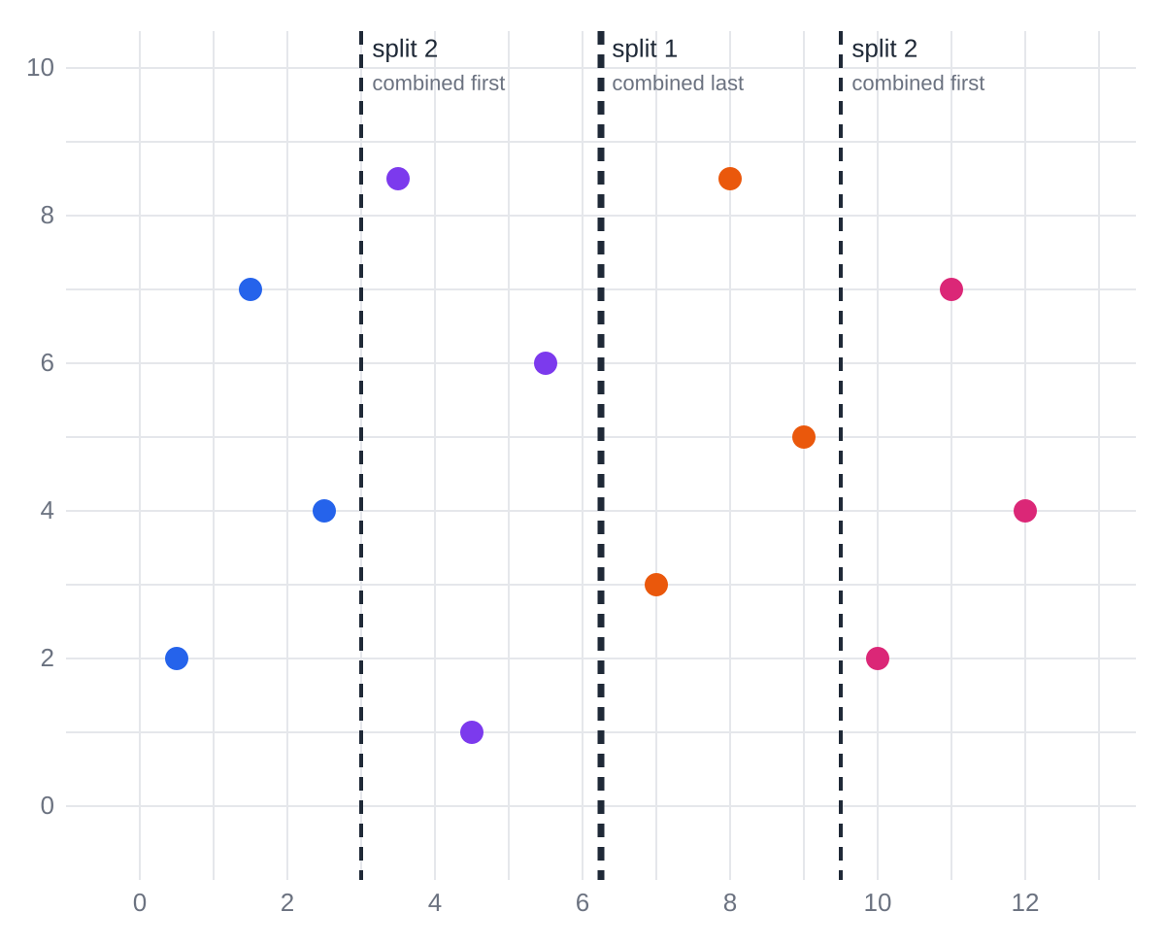
More points: split again and again
TWELVE POINTS
Split 1 makes two groups of 6. Split 2 makes four groups of 3, one per color.
Each group of 3 is measured directly.
Going up, each split 2 line runs its own choose, strip, return first. Split 1 runs last.
A crossing pair is caught at the split that first separated its two points.

Slide 11
The distance between two points is at least their left-right gap, and at least their up-down gap.
WHY SKIPPING IS SAFE
x strip: more than d from the line means more than d from anything across it.
y strip: d or more above means at least d away.
Skipped points aren’t lost: pairs among them were already checked inside their own halves.

Slide 12
Why it’s fast
≤ 7
≈ 17
1
checks per strip point, because points on one side can’t crowd together
levels of splitting for 100,000 points, halving each time
sort, done once at the start; splits keep the order
About n work per level × about log n levels = n log n. For 100,000 points: a few million steps instead of about 5 billion.

Slide 13
The steps in order
Once: sort the points by x and by y.
Going down: split at a dividing line, keeping both sorted orders. Repeat until each group has 3 or fewer points.
Bottom: measure every pair in each tiny group.
Going up, at each split: choose d → x strip → y strip → return the best pair.
Top: the final combine gives the answer.
The code compares squared distances (13 instead of about 3.6): same answers, no square roots.

